Slide 1
Electronics 1 Chapter 2 Quiz 1
Mark Maddox
Electrical Engineering Program
University of Central Florida
mark.maddox2@ucf.edu
mark.maddox@analog.com

Slide 2
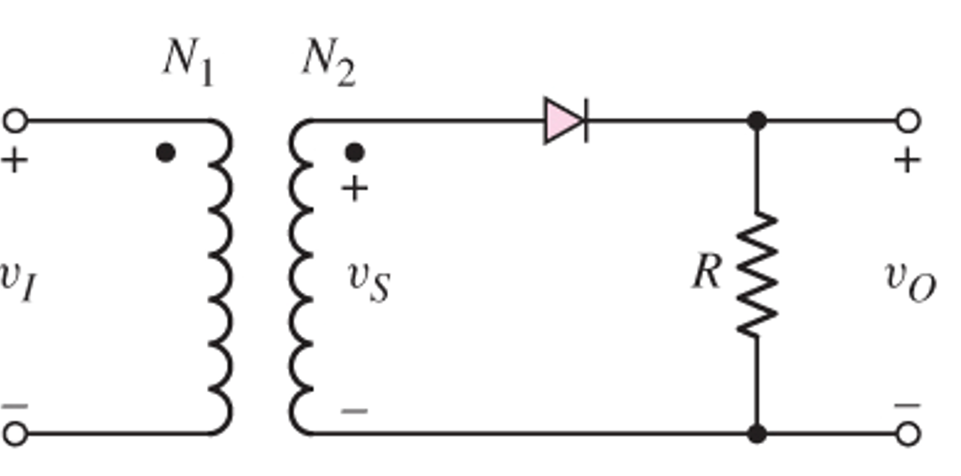
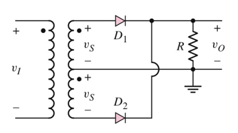
Assume the input signal to a rectifier circuit has a peak value of V_{M} = 15.7V and is at a frequency of 60Hz. Assume the load resistance is R = 2k and the ripple voltage is to be limited to V_{r} = 0.1V. Determine the capacitance required at the output of the diodes to yield this specification for,
A full-wave rectifier
b) A half-wave rectifier

Slide 3
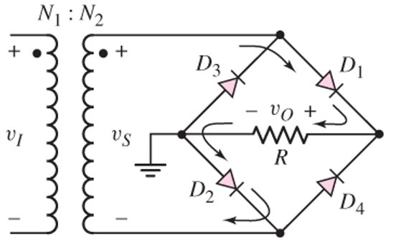
2) The peak output voltage of the full-wave bridge rectifier shown above is to designed to be 9v with a nominal load current of 100mA. The ripple voltage should be limited to Vr = 0.2v. The input signal voltage is v_{I} = 170sin[2π(60)t]V. Assume the diode cut-in voltage is 0.8v.
a) Determine the required turns ratio of the transformer.
b) Determine the minimum value of a capacitor placed across the load to achieve the required ripple voltage.
c) Find the required minimum PIV rating of the diodes

Slide 4
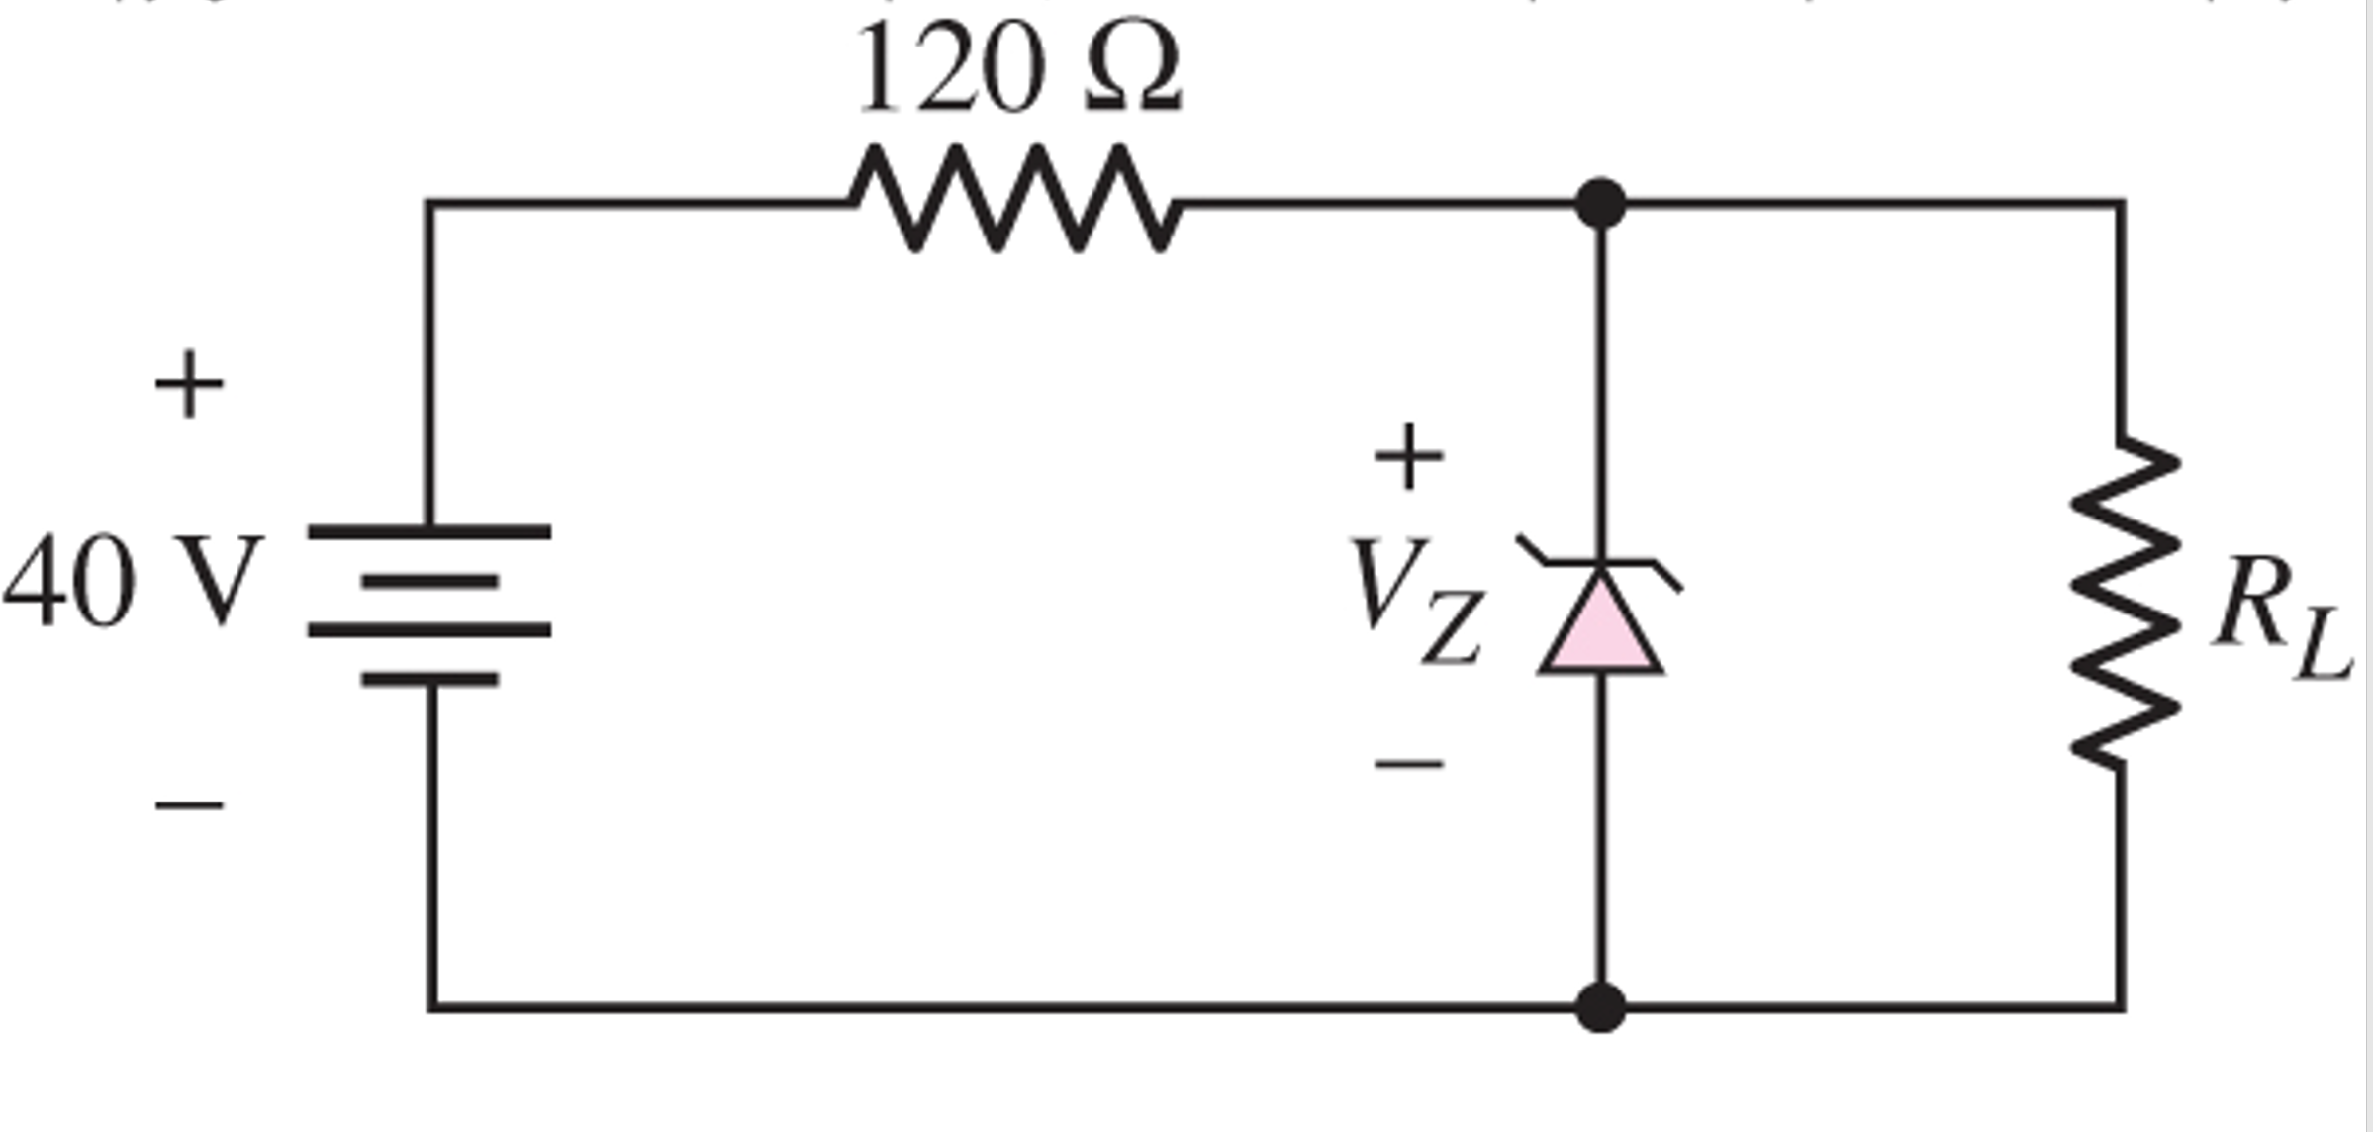
R
3) In the circuit shown above the Zener diode voltage is 12v and the Zener incremental resistance is 0.
a) Determine I_{Z} and the power dissipated in the Zener diode for R_{L} = ∞
b) Find the value of R_{L} that will set the Zener current to 1/10 of the current in part a.

Slide 5
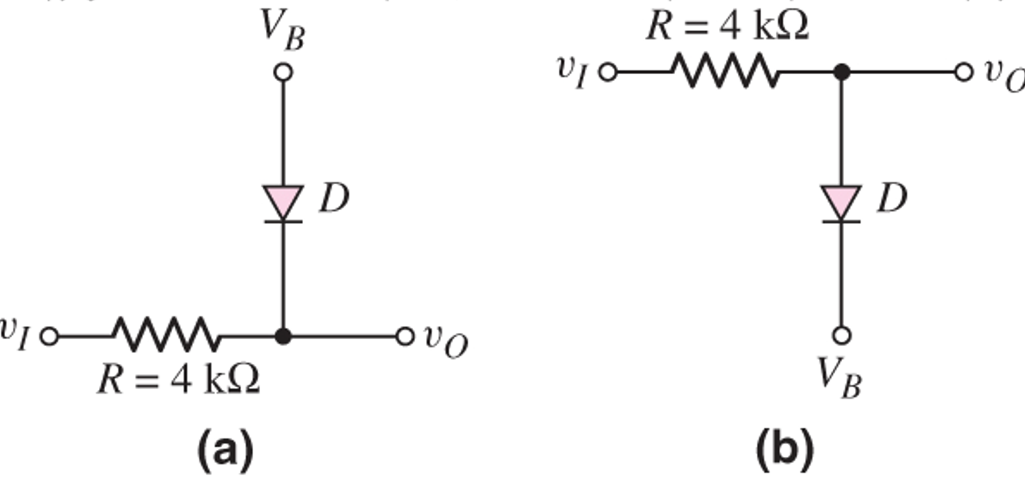
4) In the clipper circuits shown above assume the cut-in voltage for the diodes is 0.7V. Assume VI is a ramp voltage going from -5V to +5V.
a) For V_{B} = 1.8v, sketch v_{o} versus vi for both circuits

